Slide 1



VOIS Innovation
Marathon 2.0

Slide 2



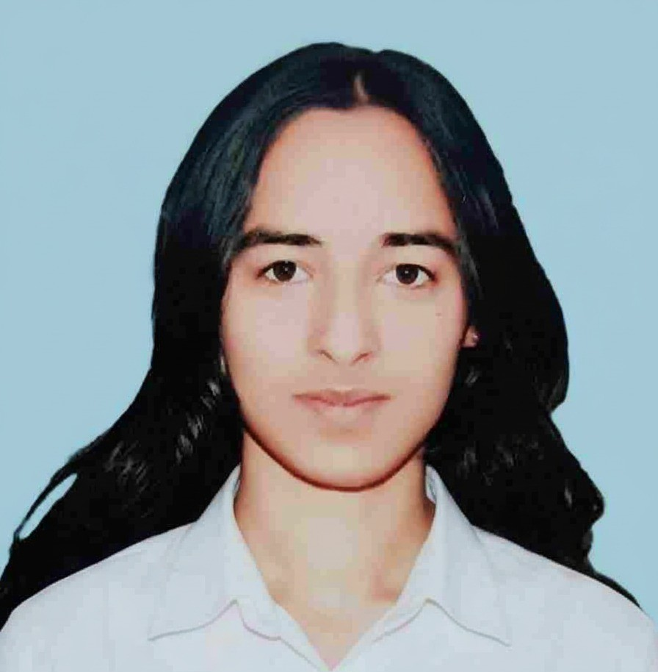
Project Title
Insert your professional photo
Team No. 85
Team Lead, Soham Mule, AI&DS
Insert your professional photo
Insert your professional photo
Insert your professional photo
PVG COET & M Pune & Maharashtra
Aditya Tilekar, AI&DS
Komal, AI&DS

Slide 3
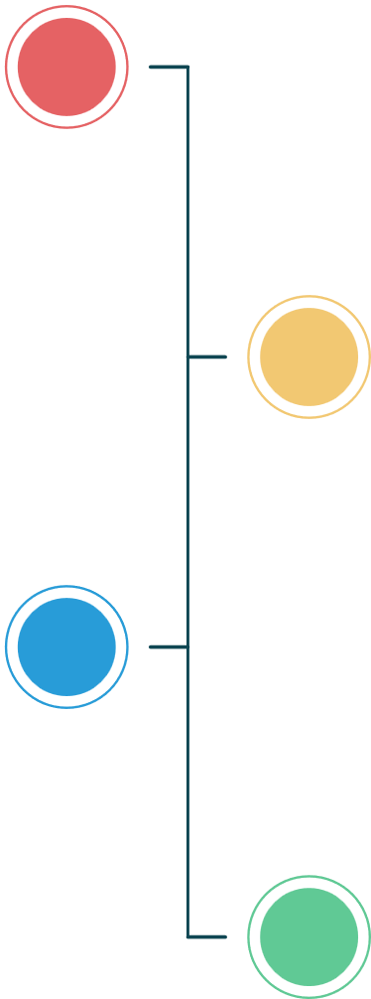




Problem Statement
Travel Agent
The Challenge: Urban commuters often struggle with fragmented transport information spread across separate apps for buses, metros, and cab services. This leads to confusion, poor time planning, and higher travel costs. There is a need for a unified platform that aggregates all transport modes in one place and recommends the best travel option based on time, convenience, and budget. The proposed system solves this by providing real-time data and intelligent route suggestions to improve overall commuting efficiency.
Fragmented Transport Information
Lack of Real-Time & Predictive Insights
Inefficient Multimodal Routing
Need for a Unified Mobility Platform
A centralized Route Sync dashboard is required to integrate tracking, forecasting, routing, and booking for efficient urban commuting.

Slide 4
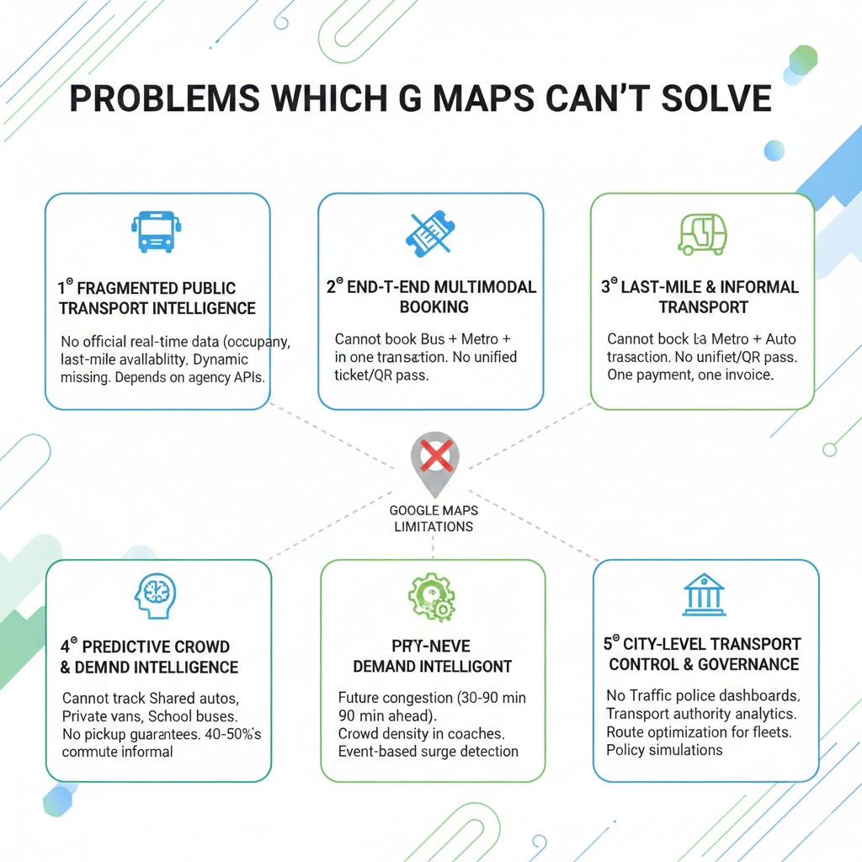
Need of Project
Route Sync is proposed as a unified, research- driven solution integrating public transports and cab services which operate on disconnected platforms.
Route Sync provides integrated planning across transport modes thus results in efficient & optimized route selection.
Route Sync bridges the gap of:
Real-time and predictive transport data
Ride and vehicle availability forecasting
Multimodal route planning

Slide 5
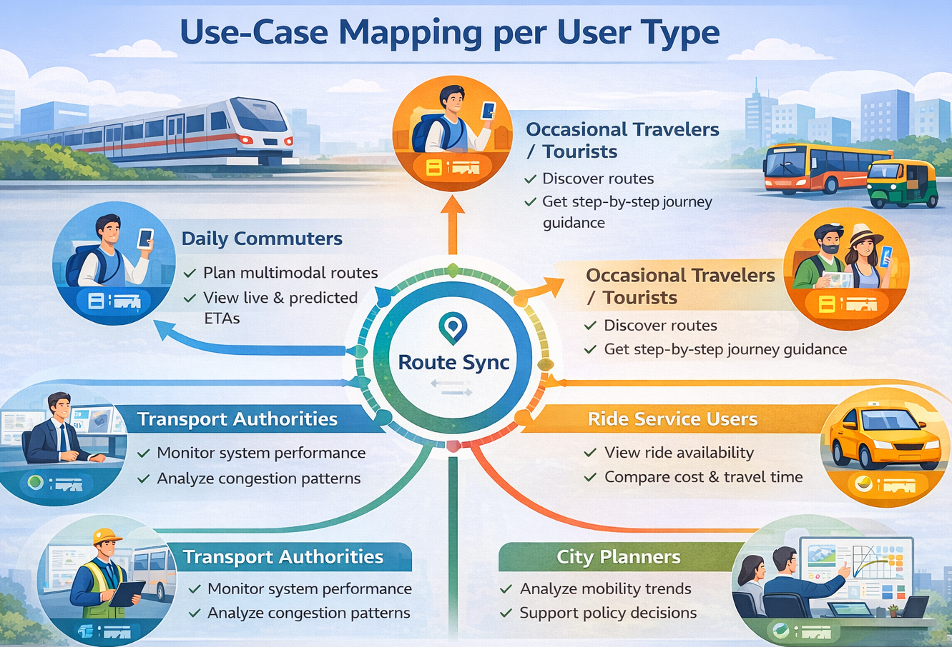
Proposed Solution
RouteSync is a multimodal mobility orchestration platform designed to eliminate urban fragmentation. By leveraging real-time data aggregation and a proprietary heuristic engine, RouteSync transforms chaotic transit variables into a streamlined, 'single-pane-of-glass' experience. Our solution doesn't just suggest routes; it optimizes the urban commute through data-driven cost-benefit analysis and hyper-personalized safety protocols. With integrated family-link connectivity and real-time telemetry, RouteSync is setting the new standard for secure, frictionless, and intelligent urban navigation. Core Capabilities
1. Real-Time Data Aggregation 2. Proprietary Optimization Engine 3. Unified User Experience (“Single Pane of Glass”) 4. Data-Driven Cost–Benefit Analysis 5. Hyper-Personalized Safety Protocols 6. Family-Link Connectivity 7. Real-Time Telemetry and Monitoring

Slide 6
Solution Overview
Unified Urban Mobility Platform
A centralized platform that integrates public transit and on-demand transportation services into a single interface.
Seamless Multimodal Journey Planning
Enables end-to-end journey planning across multiple transport modes and also provides best optimized route
Predictive Intelligence & Advanced Analytics
Accurate vehicle arrival time forecasts
Predictive vehicle availablity and location tracking
Optimized First- and Last-Mile Connectivity
Minimizes waiting times through predictive insights.
Improves transfers between mass transit and last-mile transport options.
AI based assistance
Route Sync has RAAHI AI supports complete voice based assistance, with regional language support
Scalable & Smart-City Aligned Architecture
Transforms fragmented transport systems into a data-driven, commuter-centric mobility ecosystem.
Aligned with smart city initiatives and sustainable urban transportation goals.

Slide 7














Technology used
[Mention your project technology ]
1
Frontend- HTML, CSS, JS
Backend- TypeScript, NodeJS Python, Tensorflow, Keras, for Digital Twin simulation, For analytical dashboard related to travel history: Numpy, pandas, Seaborn, Matplotlib For Database: SQL
2
Langflow platform Langflow component name - Agent , Chat input , Chat output, Search API, City Selection Agent, Local Expert Agent, Travel Concierge Agent, URL
3
Gemini Model - 2.5, Hugging face models
API’s used: Leaflet library of JS, Gemini API key, Uber Sandbox
4
5

Slide 8
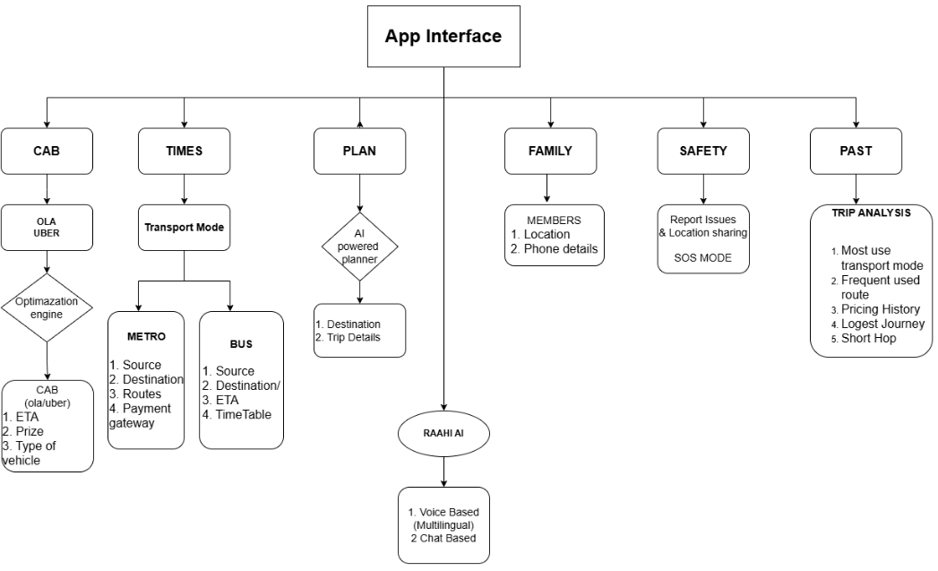
Technical flow diagram -

Slide 9
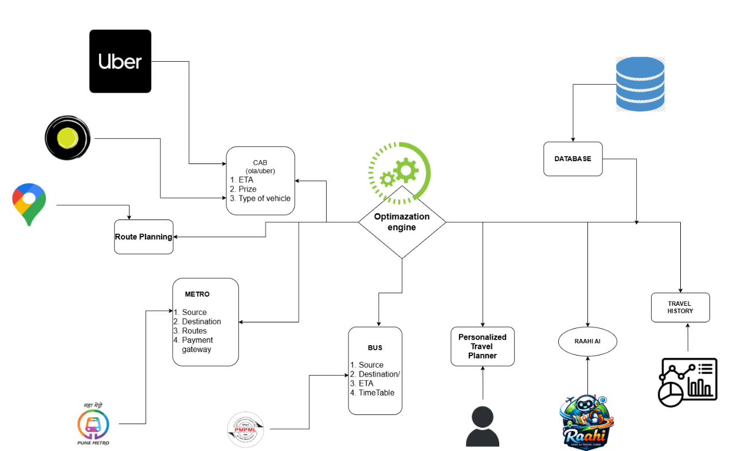
Architecture Blueprint

Slide 10
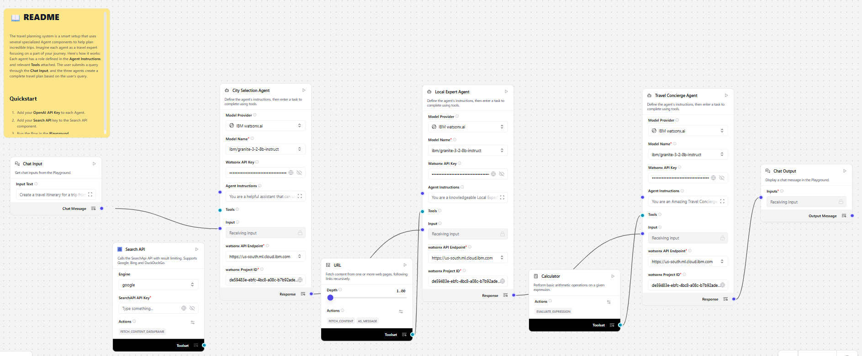
Workflow diagram
Langflow – Raahi AI Trip Planner

Slide 11
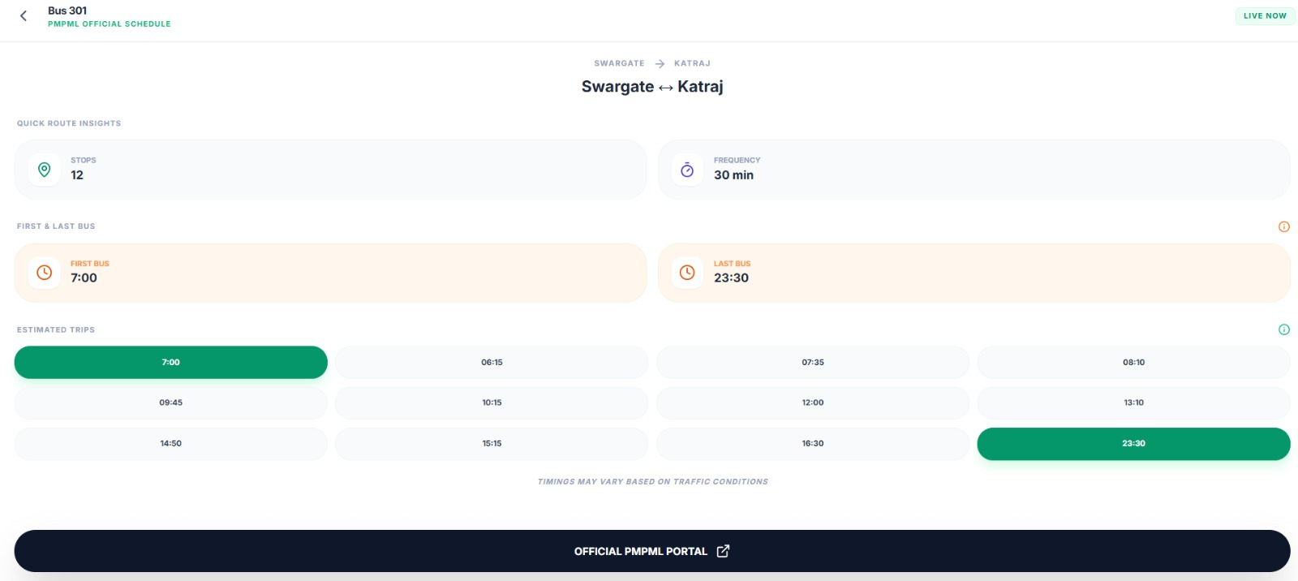
Screen shots of your project -
[Use separate slide for each screen shot- Screen shot no .1]

Slide 12
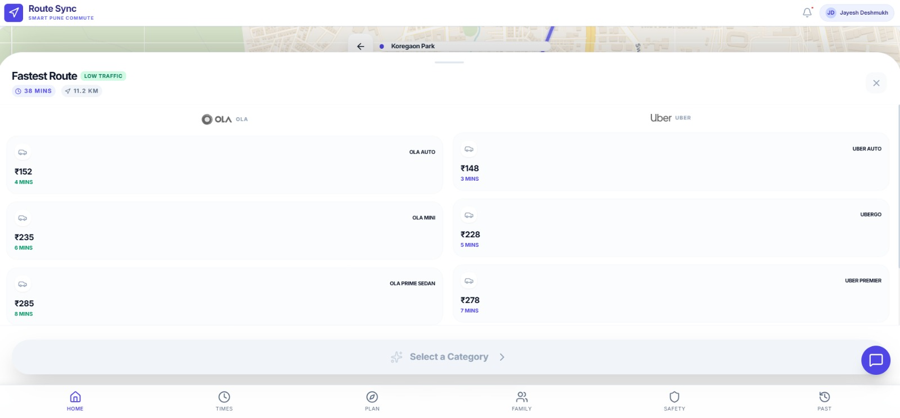
Screen shots of your project -
[Use separate slide for each screen shot – screen shot no.2]

Slide 13

Role of Agentic AI and Gen AI in the solution
1. Generative AI: The Contextual Synthesizer
Multimodal Natural Language Processing: Translates complex user intent (e.g., "I'm traveling with elderly parents and need a low-stress route") into precise algorithmic constraints.
Unified Intelligence from Fragmented Data: Ingests and synthesizes unstructured data—such as local advisories, social media alerts, and community reports—to provide a coherent "Single-Pane-of-Glass" transit briefing.
Hyper-Personalized Narratives: Replaces generic lists with tailored advice, explaining the why behind a recommendation based on user DNA and environmental context.
2. Agentic AI: The Autonomous Orchestrator
Goal-Oriented Autonomy: Unlike passive systems, Agentic AI acts as a "Digital Pilot" with a primary mission: ensuring the user reaches their destination securely and efficiently.
Proactive Journey Correction: Real-time monitoring of transit variables allows the Agent to autonomously re-route and sync micro-mobility (e.g., pre-reserving an e-bike) before the user encounters a delay.
Active Safety Intervention: Operates as a background watchdog, identifying deviations in telemetry and autonomously executing safety protocols or family alerts based on real-time risk assessments.

Slide 14
Novelty and Uniqueness
Unlike existing apps owned by transit providers (who favor their own fleets), RouteSync is Modal-Neutral. And RouteSync has Proprietary Multi-Modal Heuristic Engine which suggest best path across disconnected transit system
1
2
RAAHI AI: Multilingual Voice Orchestration: We introduce a voice-first, regional-language AI assistant that lowers the barrier to entry for diverse demographics, moving beyond traditional touch-interface limitations.
The "Single Pane of Glass" Experience: We eliminate "app fatigue" by aggregating fragmented data into one unified dashboard, reducing the cognitive load and decision-making time for daily commuters.
1
Granite‑guarded outputs ensure bias‑free, regulation‑compliant
advice.
Historical "Trip Analysis" Intelligence: Our system provides a deep-dive analysis of past behavior—tracking pricing history and "Short Hop" vs. "Longest Journey" patterns—to optimize future spending and route selection.
2

Slide 15
Git Hub Link
Please create public GitHub repository (Enable Add README button while creating repository)
with format:
The working GitHub URL – https://github.com/cdmafAdi/Tech-Mirage_85_RouteSync_2.0
Make sure you have Uploaded following three files into your github repository
1. app.py file ,
2. your_hackthon_problemstatement.pdf file
3. your projectpresntation.pptx file

Slide 16
Future Scope
Unified Mobility-as-a-Service (MaaS) Payment Integration
Implementing a single "RouteSync Wallet" that allows users to pay for buses, trains, e-bikes, and tolls across different providers with one tap, using blockchain or unified QR systems to handle cross-provider settlements.
2. V2X (Vehicle-to-Everything) Connectivity
Integrating with Smart City IoT (Traffic lights, street sensors, and public Wi-Fi) to provide millisecond-accurate data. RouteSync could eventually "request" a green light for a delayed public bus to keep thousands of commuters on schedule.
3. Completer Implementation of Predictive "Digital Twin" Modeling
Vision: Using historical data for Urban Planning Insights.
Detail: Leveraging anonymized commuter patterns to create a "Digital Twin" of the city. This data can be sold to city planners to help them decide where to build new bike lanes or bus routes based on real-world demand gaps identified by RouteSync
4. Scaling RouteSync to multiple cities across India. 5.
Proprietary Carbon-Footprint Calculation: Our optimization engine integrates a real-time carbon emission coefficient for every transport mode—calculating the CO^2 output based on vehicle type, traffic congestion, and distance

Slide 17
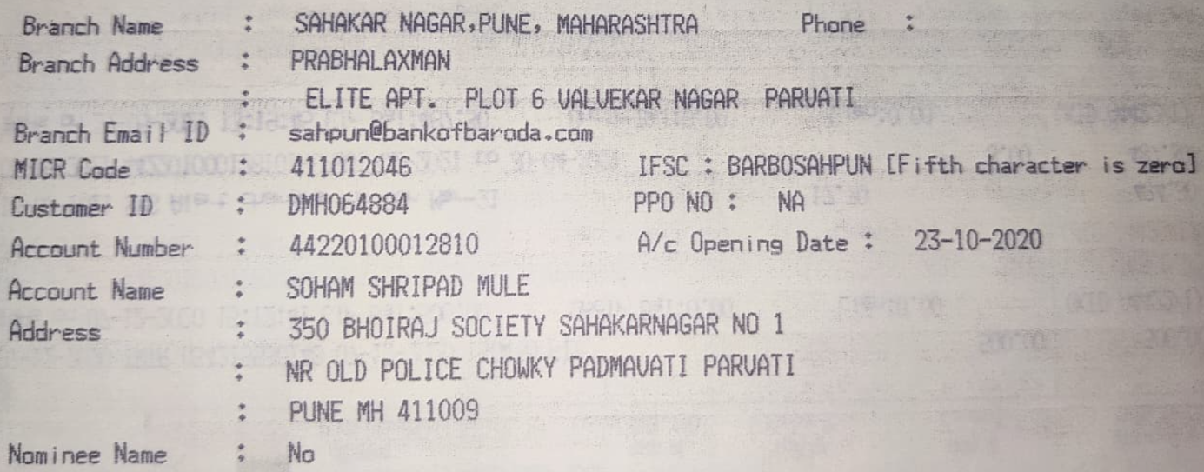
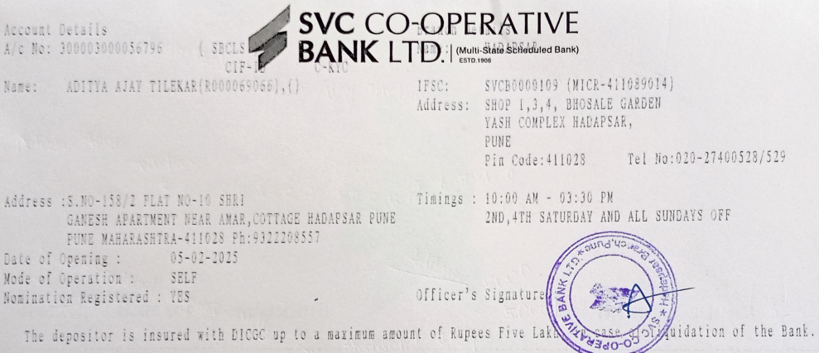
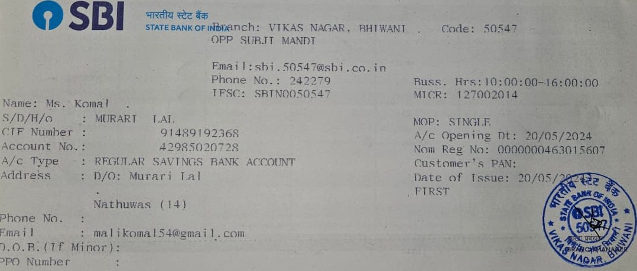
Bank Details
Full Name (as per bank records): | Bank Name | Branch Name | Account Number | Account Type (Savings / Current) | IFSC Code
Soham Shripad Mule | Bank of Baroda | Sahakar Nagar | 44220100012810 | Savings | BARB0SAHPUN
ADITYA AJAY TILEKAR | SVC Co-operative BANK LTD. | Hadapsar | 300003000056796 | Savings | SVCB0000109
Ms. Komal | SBI | Vikas Nagar,Bhiwani | 42985020728 | Savings | SBIN0050547
Insert photo of passbook / bank statement
Insert photo of passbook / bank statement
Team Member 1 Passbook/ Bank Statement With Name and Account Number
Team Member 2 Passbook/ Bank Statement With Name and Account Number
Team Member 3 Passbook/ Bank Statement With Name and Account Number

Slide 18
Thank You
-Team TECH-MIRAGE

